Slide 1
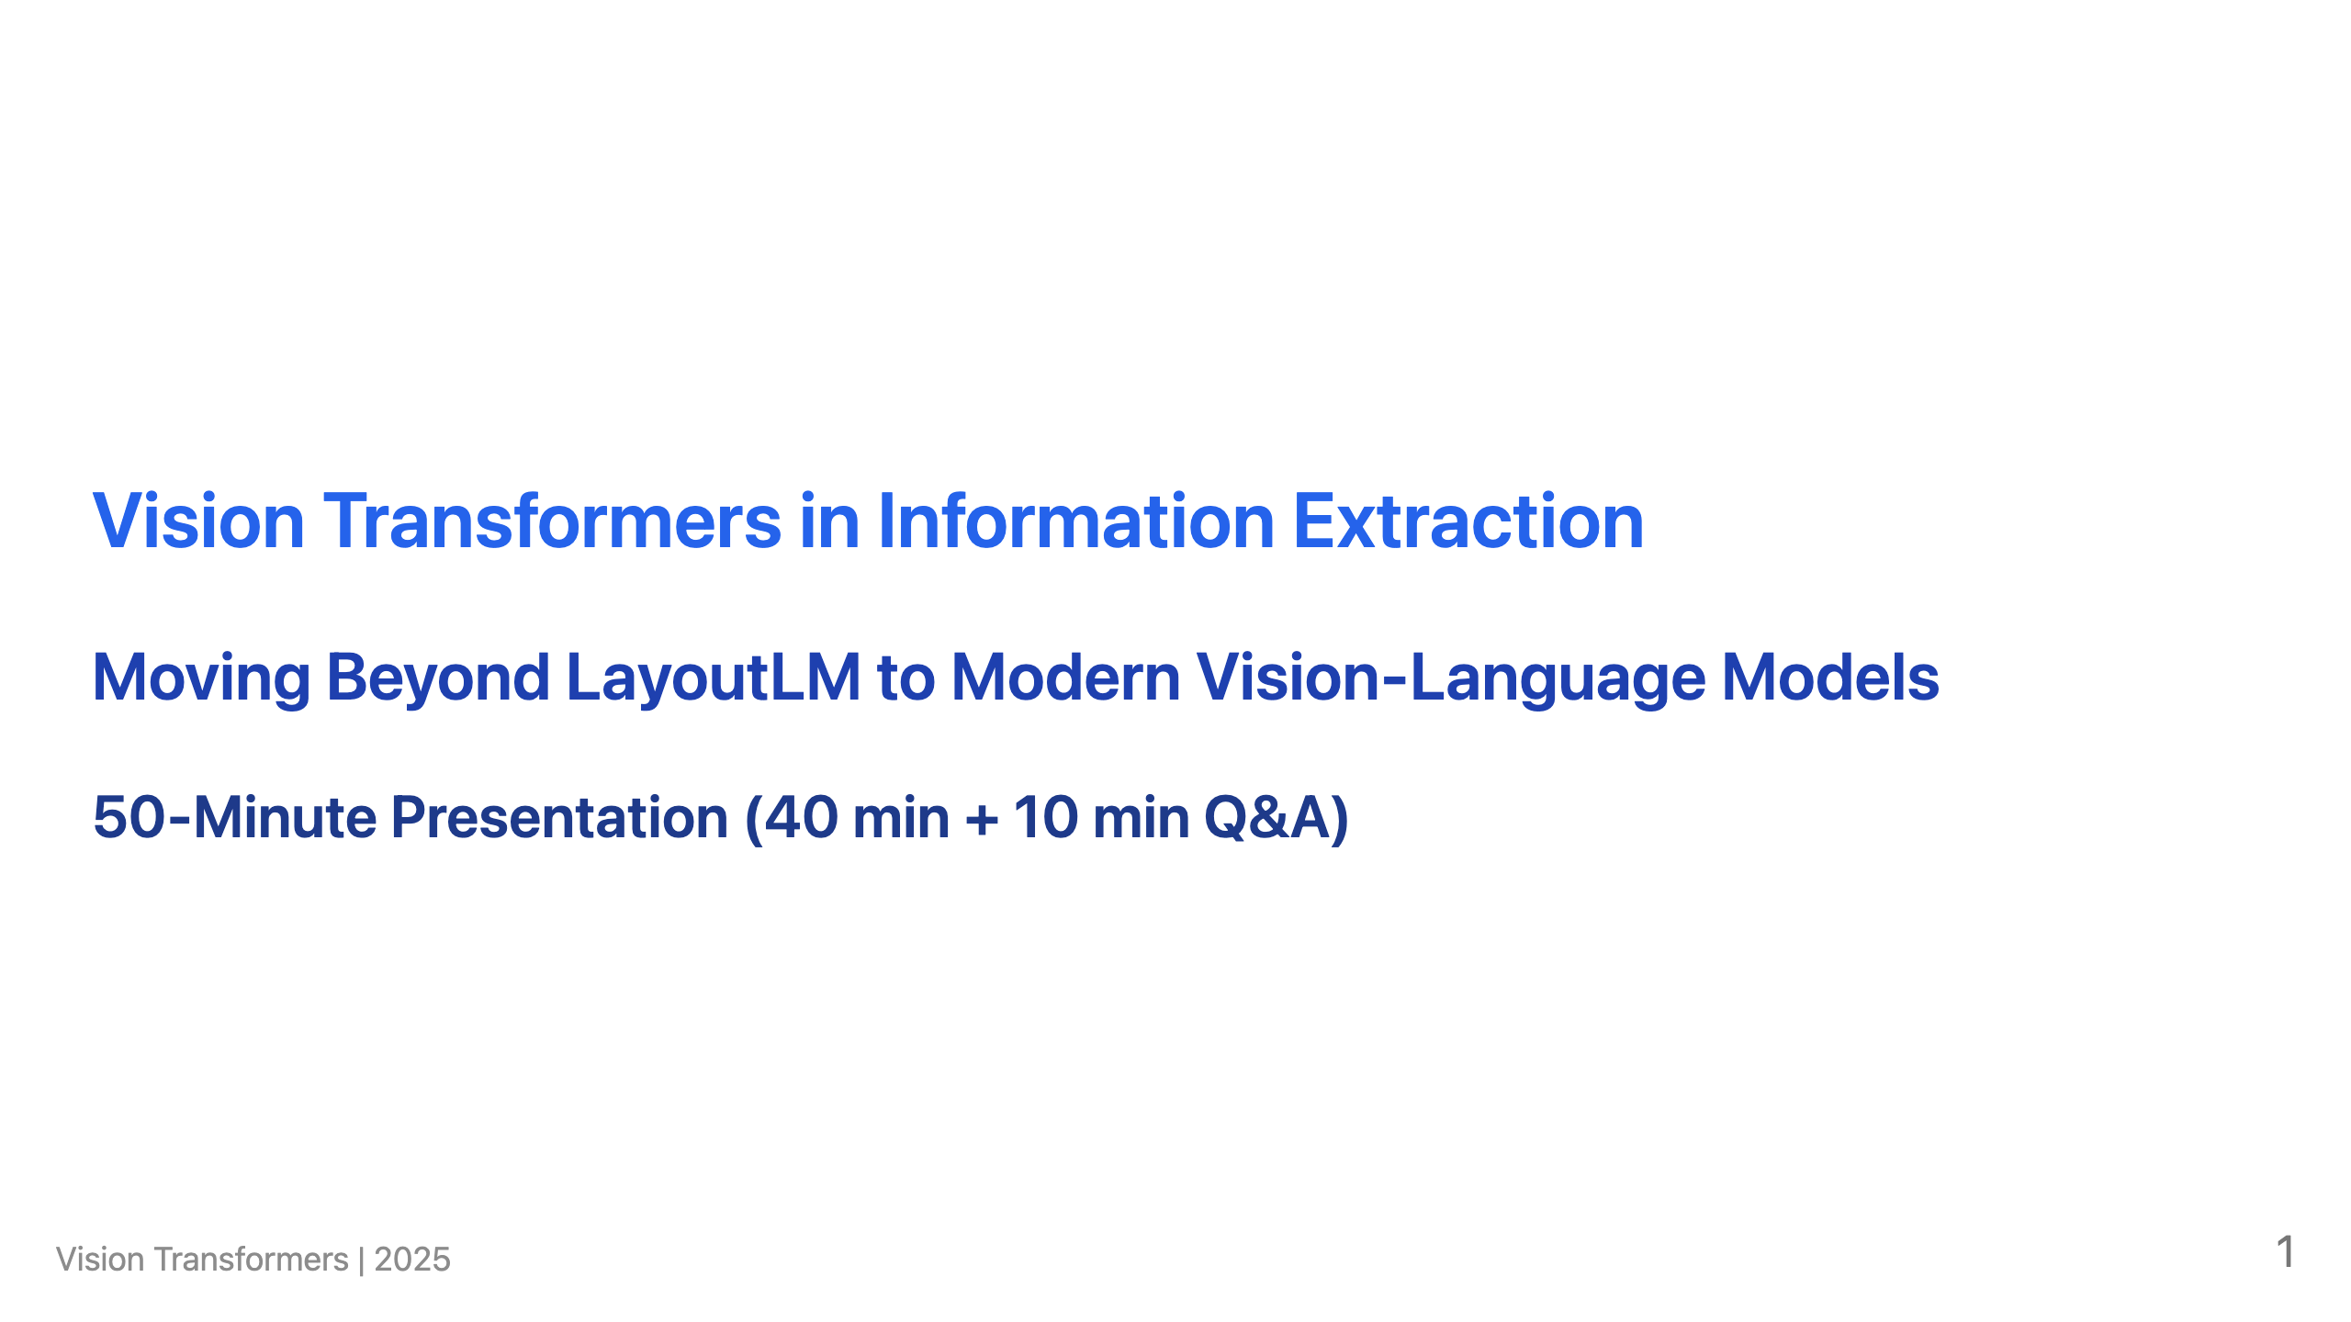

Slide 2
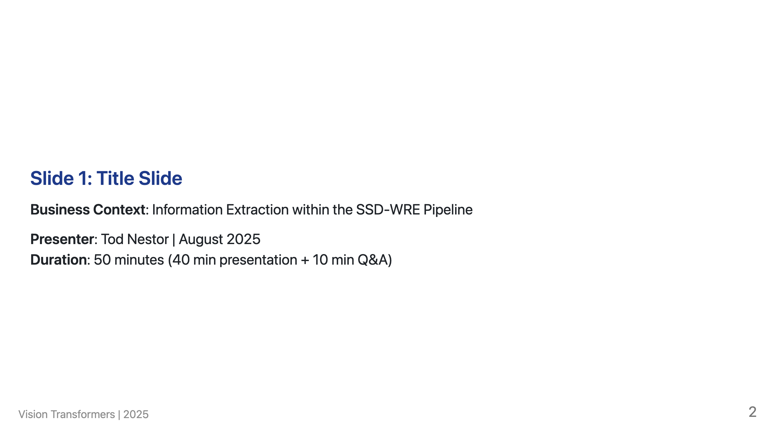
Notes:
Speaker Notes: Welcome everyone. Today we're exploring a critical technology decision that could transform how we process tax document substantiation. The Business Challenge: During taxtime, the ATO processes thousands of expense claim documents daily. Taxpayers submit receipts, invoices, and statements to support their deductions, and audit officers must verify these claims by extracting key information from each document. Current Reality: This information extraction is currently automated using LayoutLM technology, but we're hitting performance and reliability limits that are creating bottlenecks in the substantiation pipeline. Today's Question: Can modern Vision Transformers provide a better solution? This PoC presentation will show you the evidence and help inform our technology strategy moving forward.

Slide 3
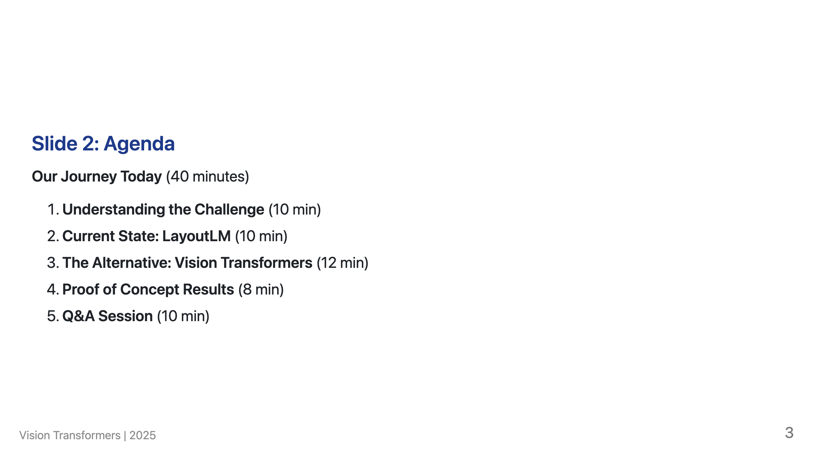
Notes:
Speaker Notes: We'll build understanding step by step - from the business context through to technical evidence. By the end, you'll have the information needed to evaluate this technology decision.

Slide 4
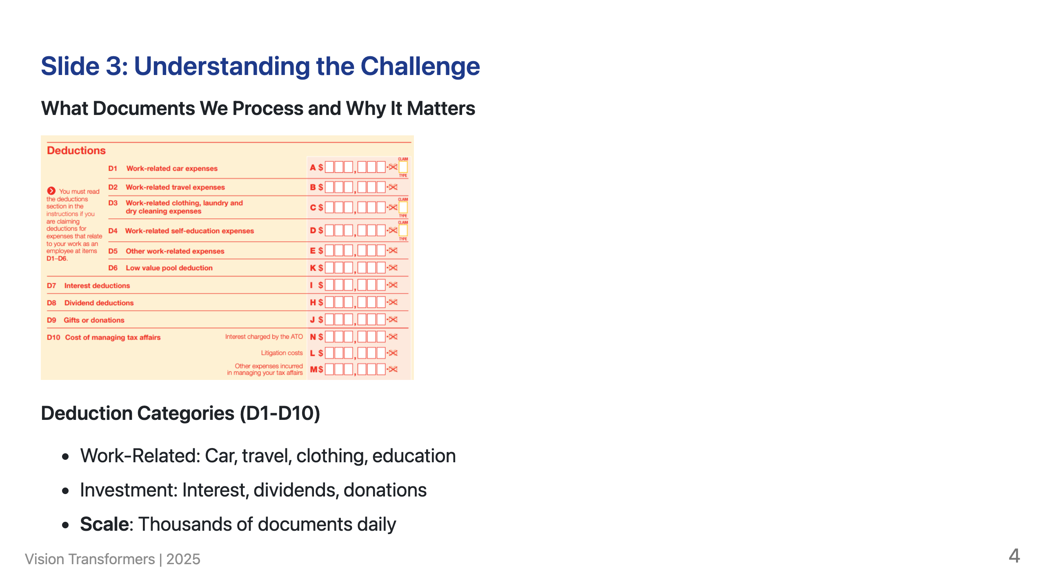
Notes:
Speaker Notes: This visual shows the actual tax return deductions structure. Each category (D1-D10) requires supporting evidence: receipts, invoices, bank statements. Every document needs accurate field extraction - supplier names, ABNs, amounts, dates - to verify claims and categorize them correctly.

Slide 5
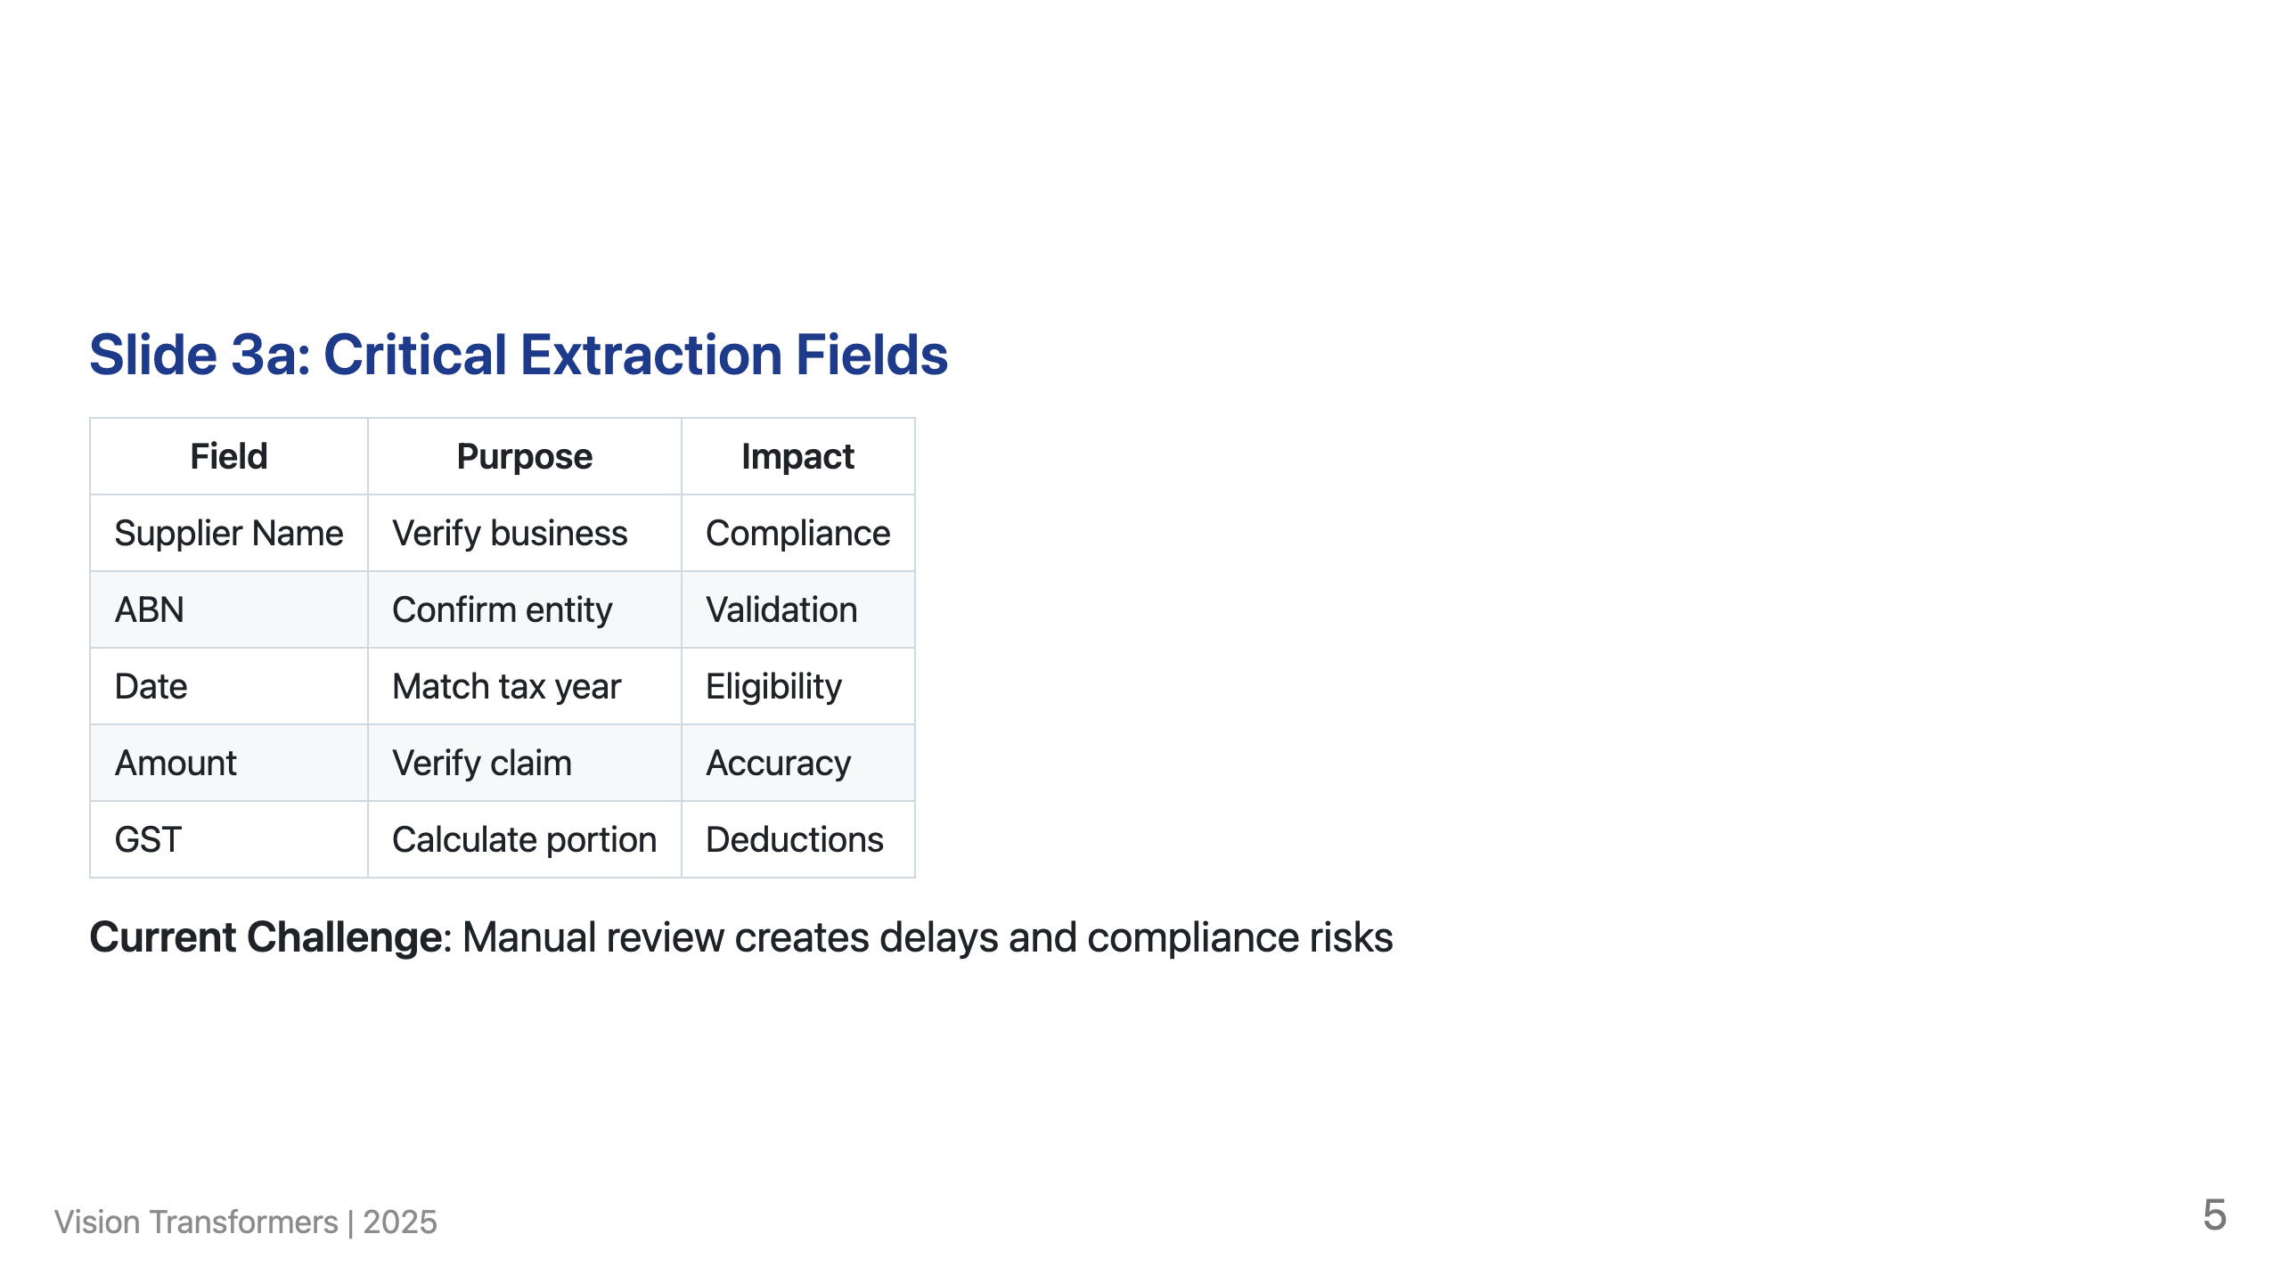
Notes:
Speaker Notes: These are the critical fields we must extract from every document. Manual processing of thousands of documents per audit cycle is unsustainable.

Slide 6
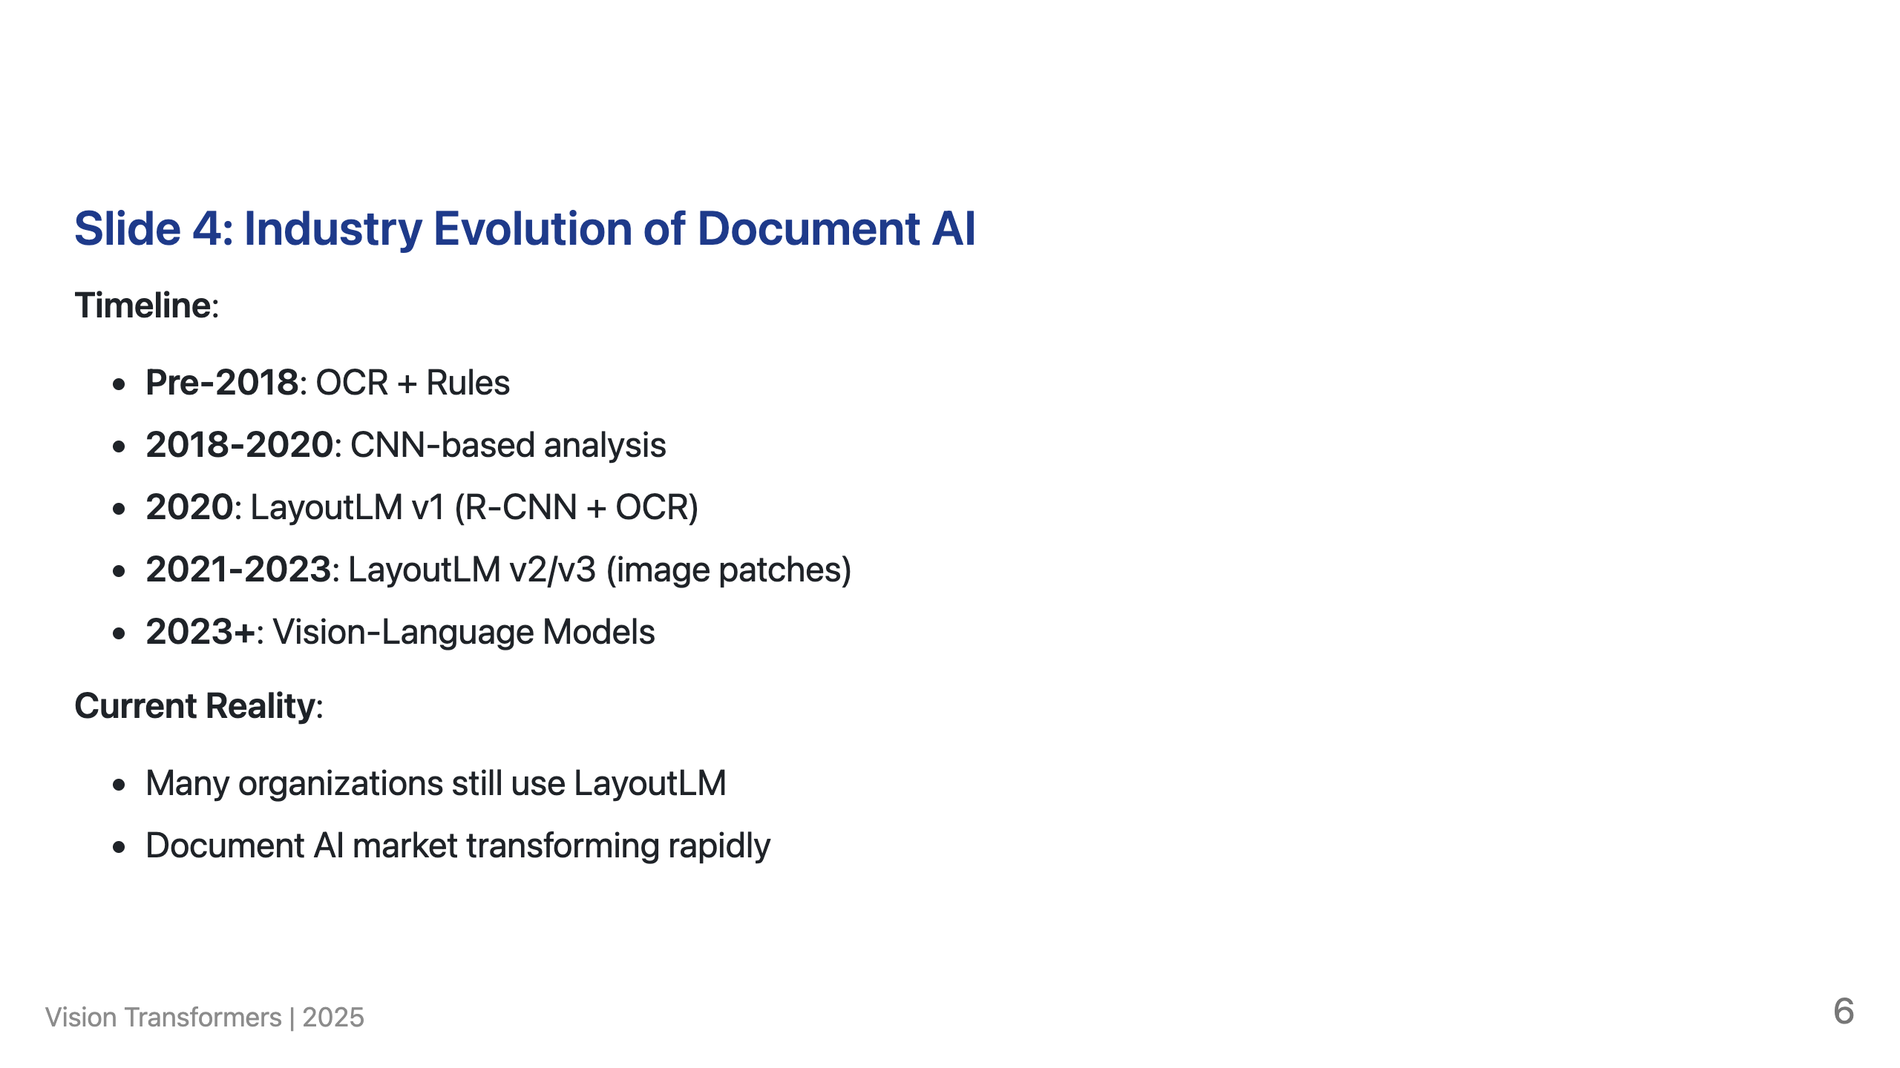
Notes:
Speaker Notes: This evolution reflects global trends. Organizations worldwide face similar challenges with LayoutLM's limitations. Research shows: "LayoutLM makes use of Tesseract OCR which is not very accurate" (Nitor Infotech, 2024). "Training LayoutLM can be computationally intensive" (UBIAI, 2024). Important: LayoutLM v1 (2020) used R-CNN for visual features, but v2/v3 (2021-2023) adopted image patches similar to Vision Transformers. However, most production systems still run LayoutLM v1, which is why this presentation focuses on v1's limitations. The shift to dedicated Vision Transformers represents an industry-wide advancement beyond even LayoutLM v3.

Slide 7
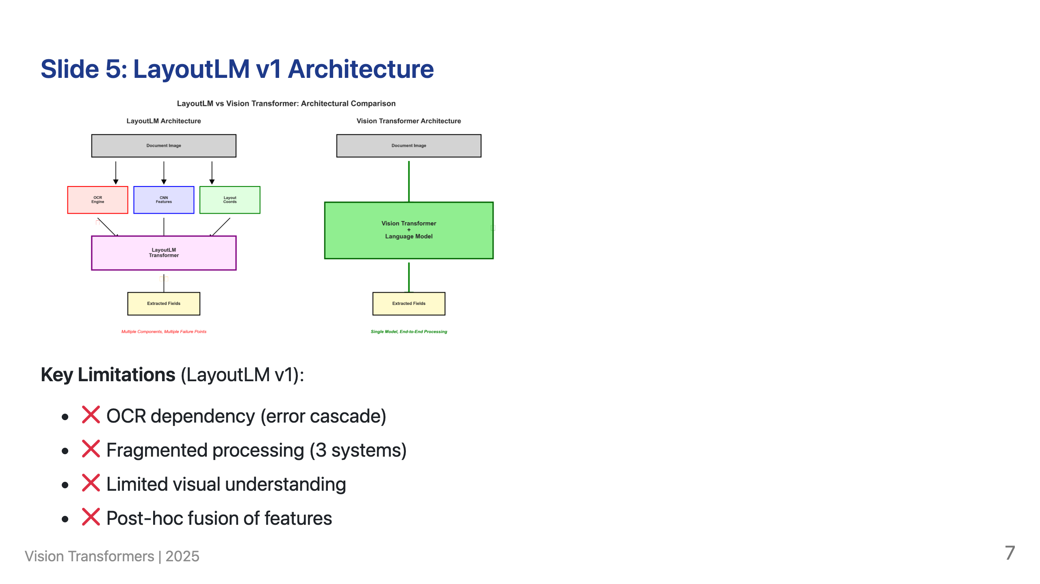
Notes:
Speaker Notes: LayoutLM fragments semantic understanding across three separate systems. OCR extracts words as isolated tokens - if OCR fails, everything fails. Visual features are minimal and disconnected from text. The three streams are awkwardly combined in the transformer, losing information at each stage. Rich visual semantics like logos, stamps, and handwriting are largely ignored. Technical Note: LayoutLM v1 specifically uses Region-based Convolutional Neural Networks (R-CNN) for visual feature extraction. R-CNNs are more sophisticated than basic CNNs, designed for object detection and region proposals, and better suited for document layout analysis. IMPORTANT: Later versions (LayoutLMv2, LayoutLMv3) actually moved away from R-CNN and adopted image patches similar to Vision Transformers. However, most production systems still use LayoutLM v1, which is why we focus on its R-CNN-based limitations in this presentation.

Slide 8
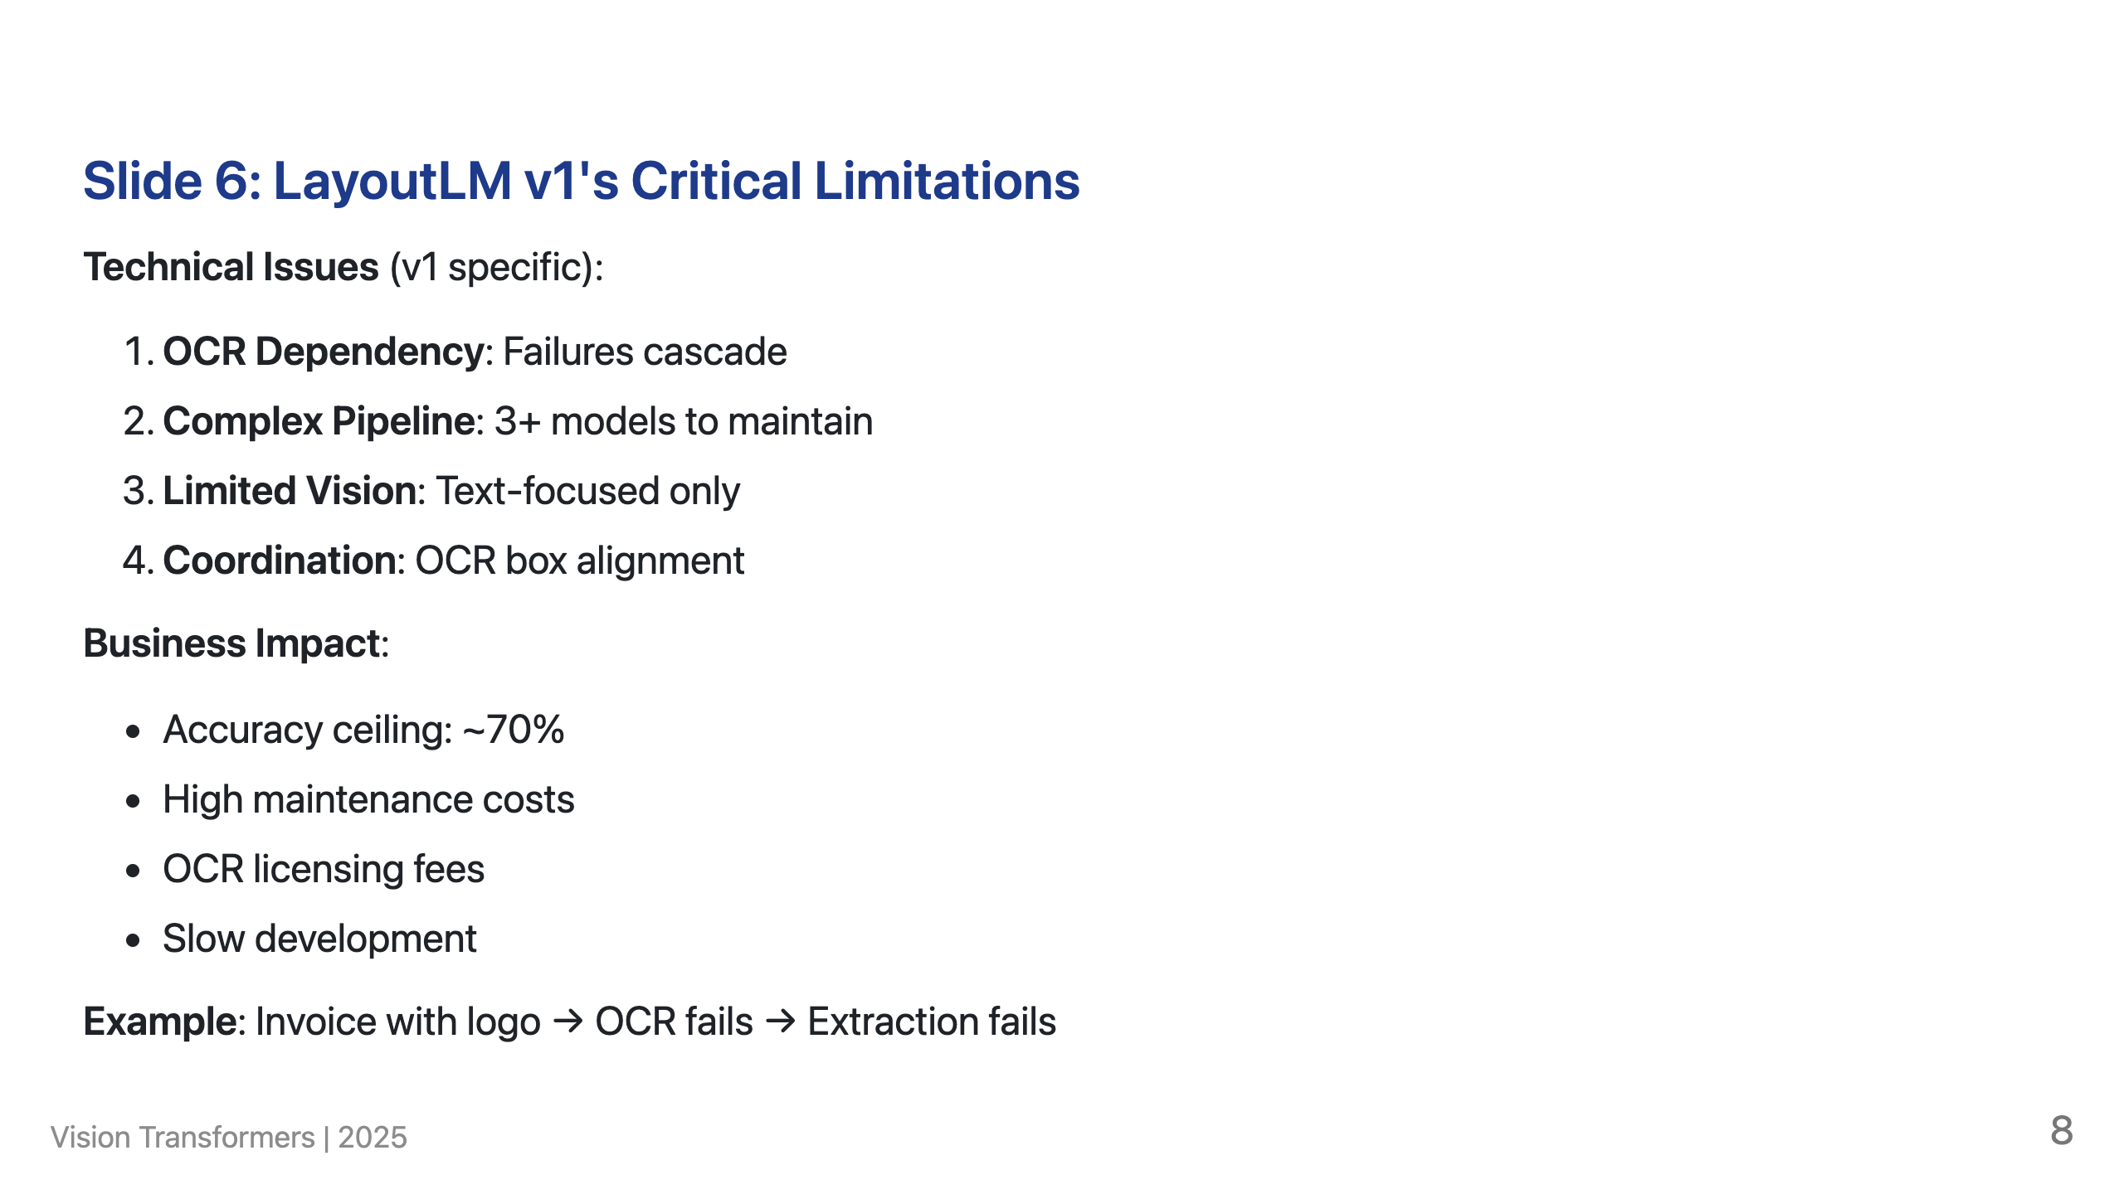
Notes:
Speaker Notes: These aren't minor issues - they're fundamental architectural limitations of LayoutLM v1 that prevent scaling and improvement. Note: Later versions (v2, v3) addressed some of these issues by adopting image patches, but most production systems still use v1.

Slide 9
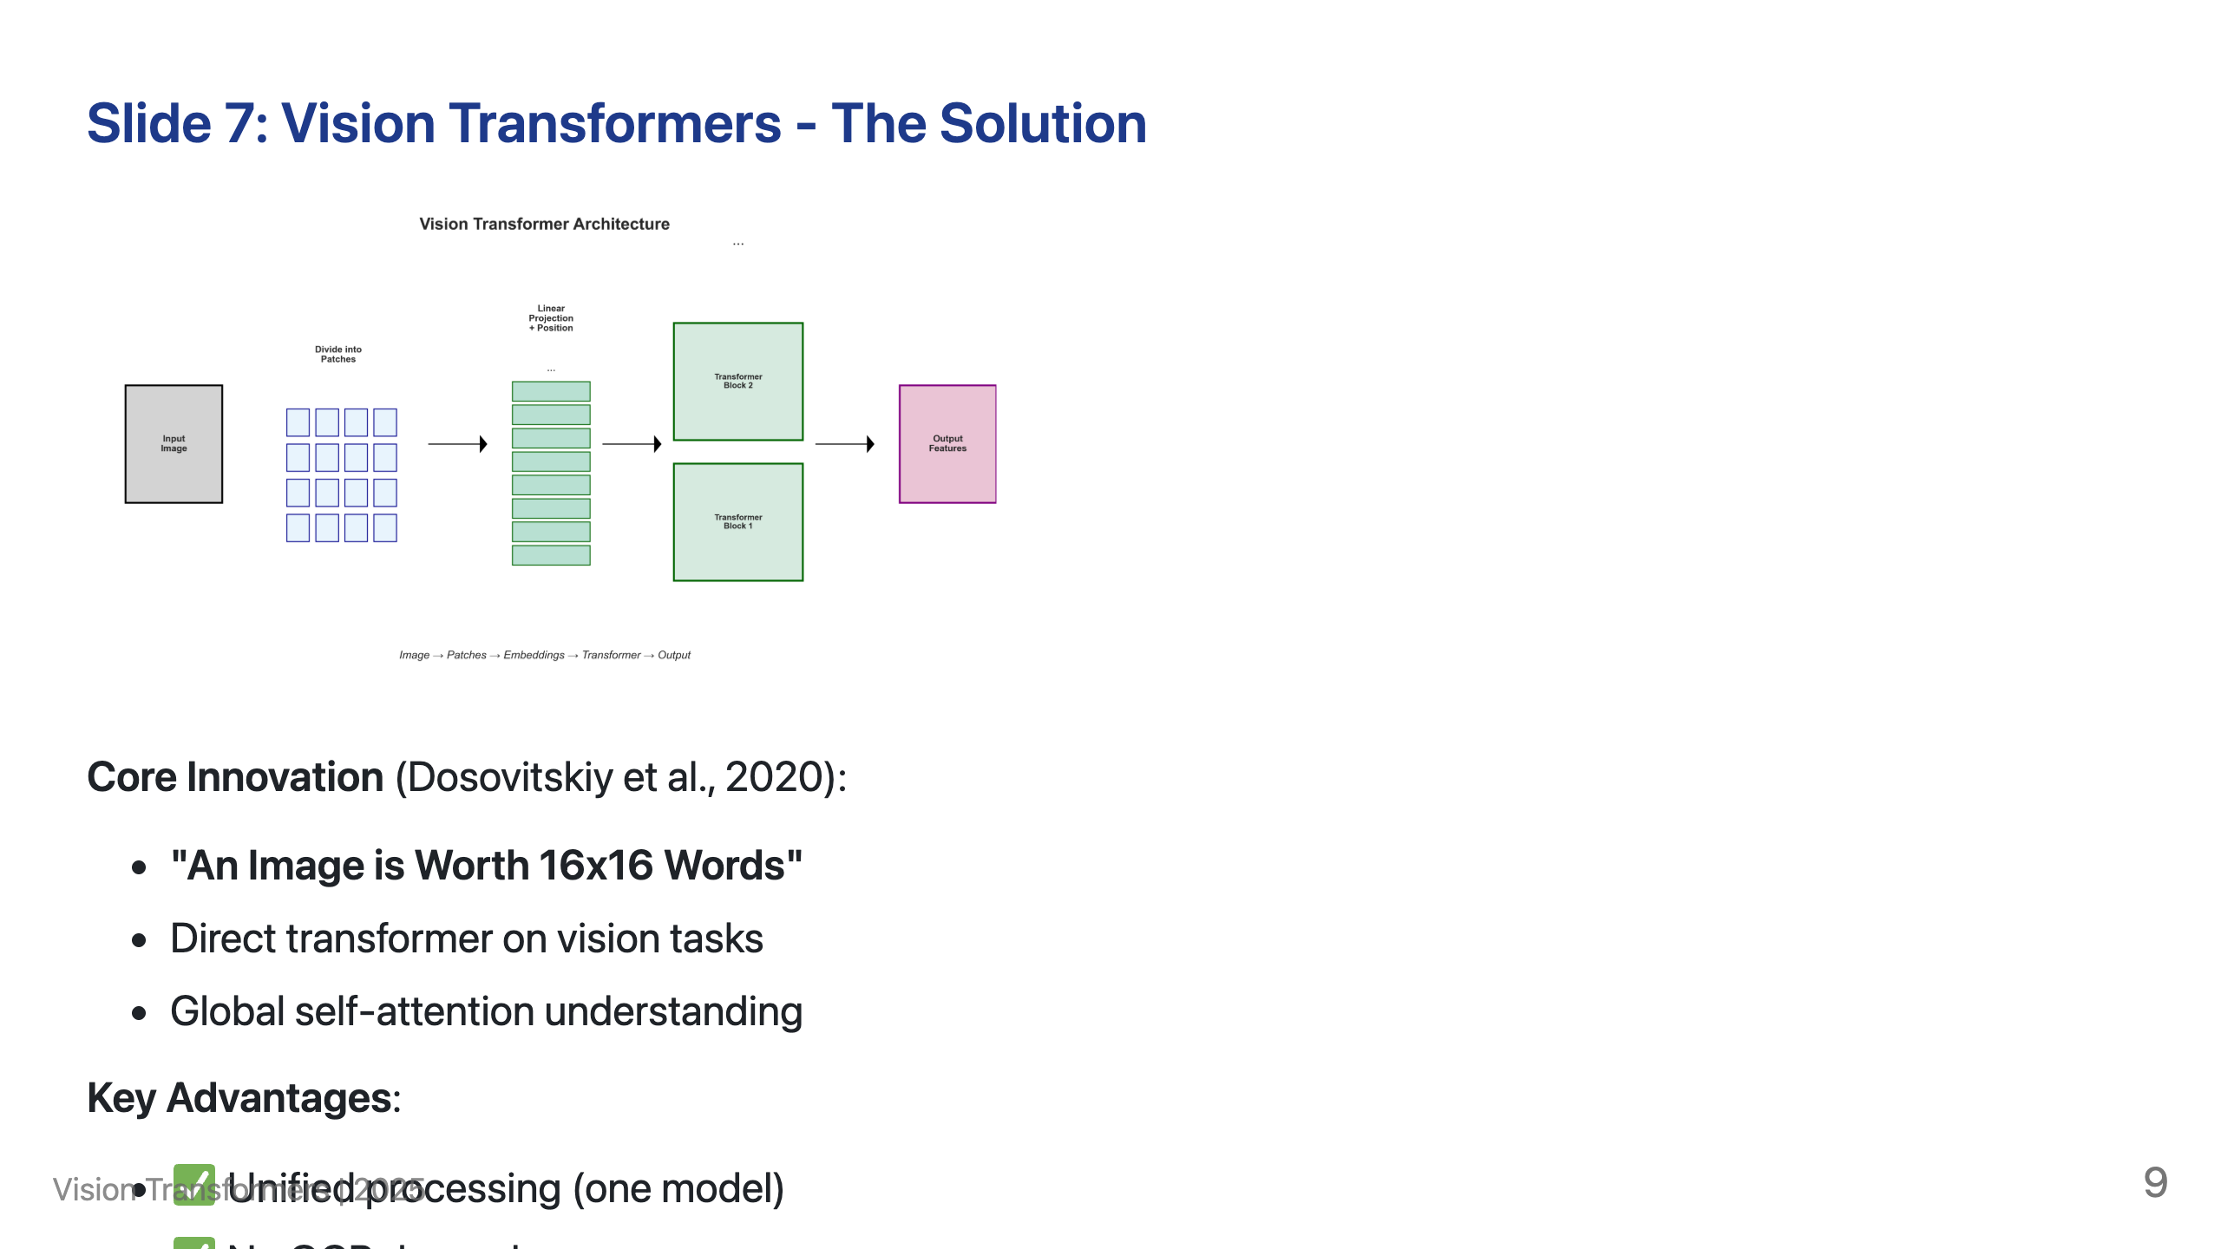
Notes:
Speaker Notes: The original ViT breakthrough enabled all modern vision-language models. Key innovation: treats image patches like text tokens, applying transformers directly. All semantics (text, visual, spatial) are unified in one model with no information loss. Modern adaptations like InternVL3 and Llama-3.2-Vision build on this foundation for document understanding.

Slide 10
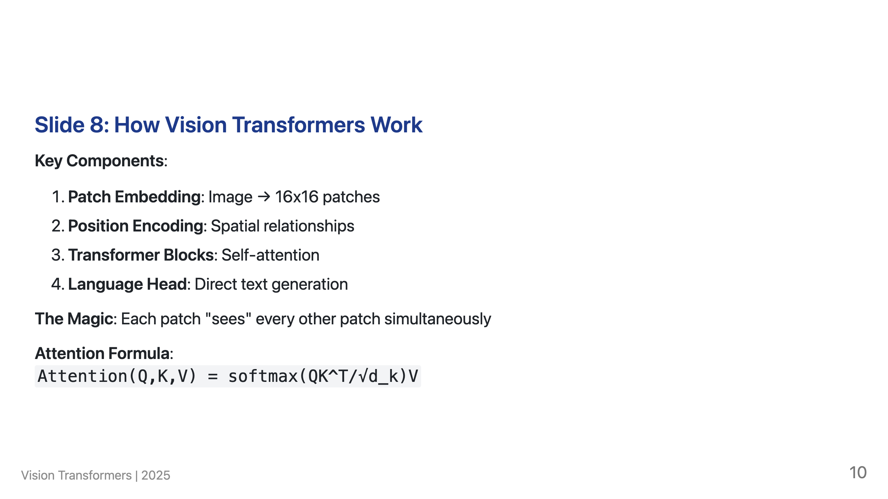
Notes:
Speaker Notes: Unlike LayoutLM's sequential processing, ViTs process the entire document holistically. The self-attention mechanism allows every patch to interact with every other patch, creating global understanding.

Slide 11
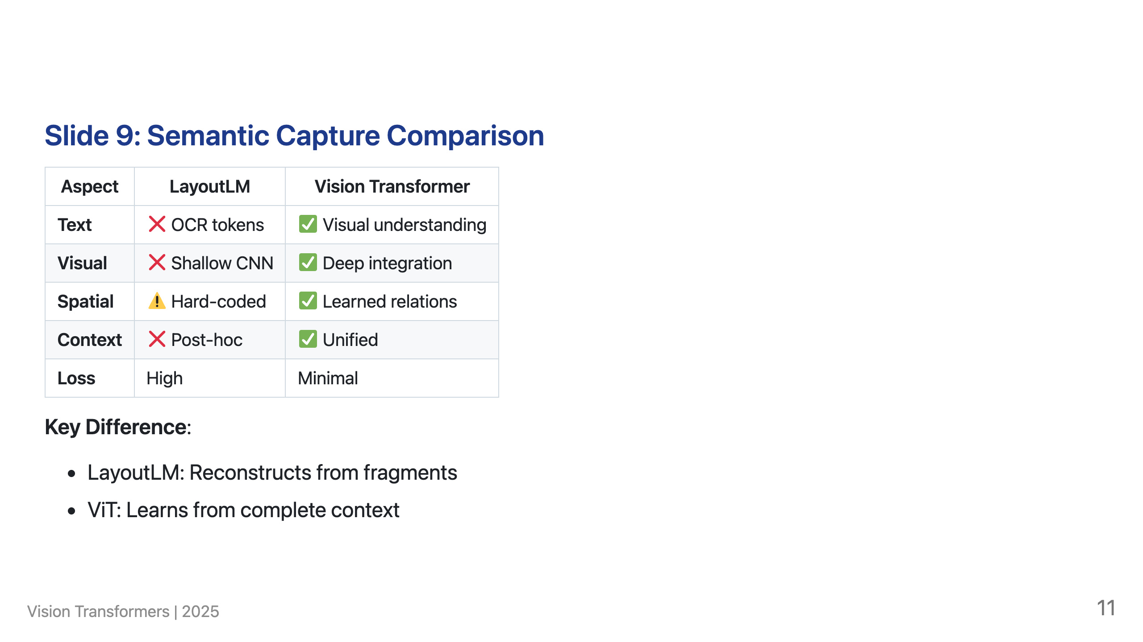
Notes:
Speaker Notes: This isn't an incremental improvement - it's a paradigm shift. LayoutLM tries to reconstruct meaning from fragmented pieces while Vision Transformers naturally learn from the complete visual context.

Slide 12
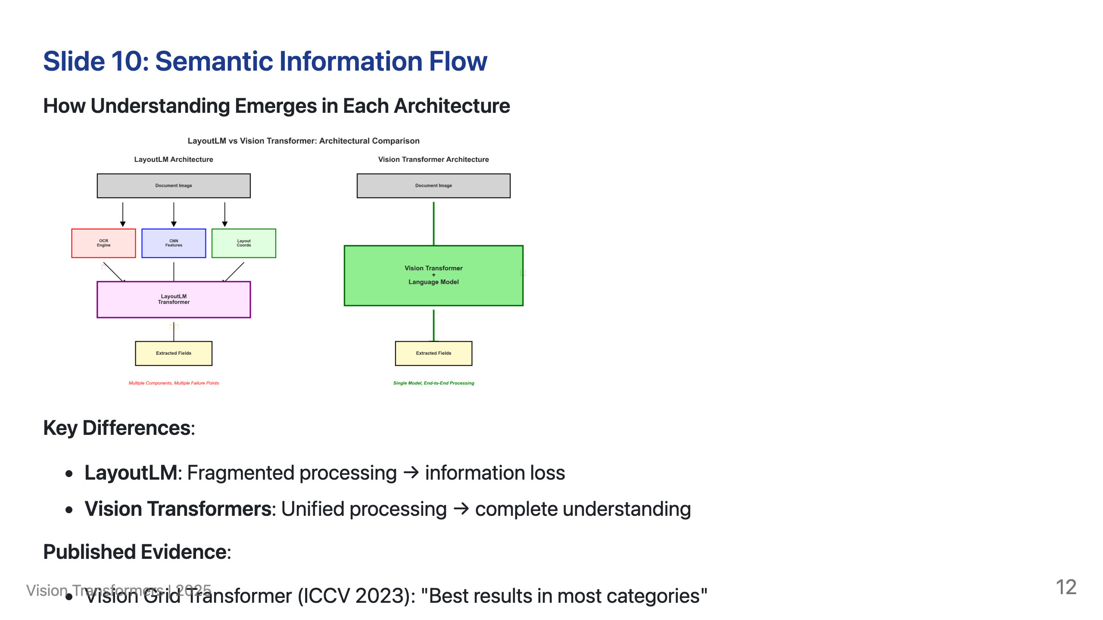
Notes:
Speaker Notes: The architecture determines semantic capture quality. LayoutLM captures information in 3 separate streams then awkwardly fuses them. Vision Transformers capture information holistically from the start. Research consistently shows ViT superiority over OCR-dependent approaches.

Slide 13
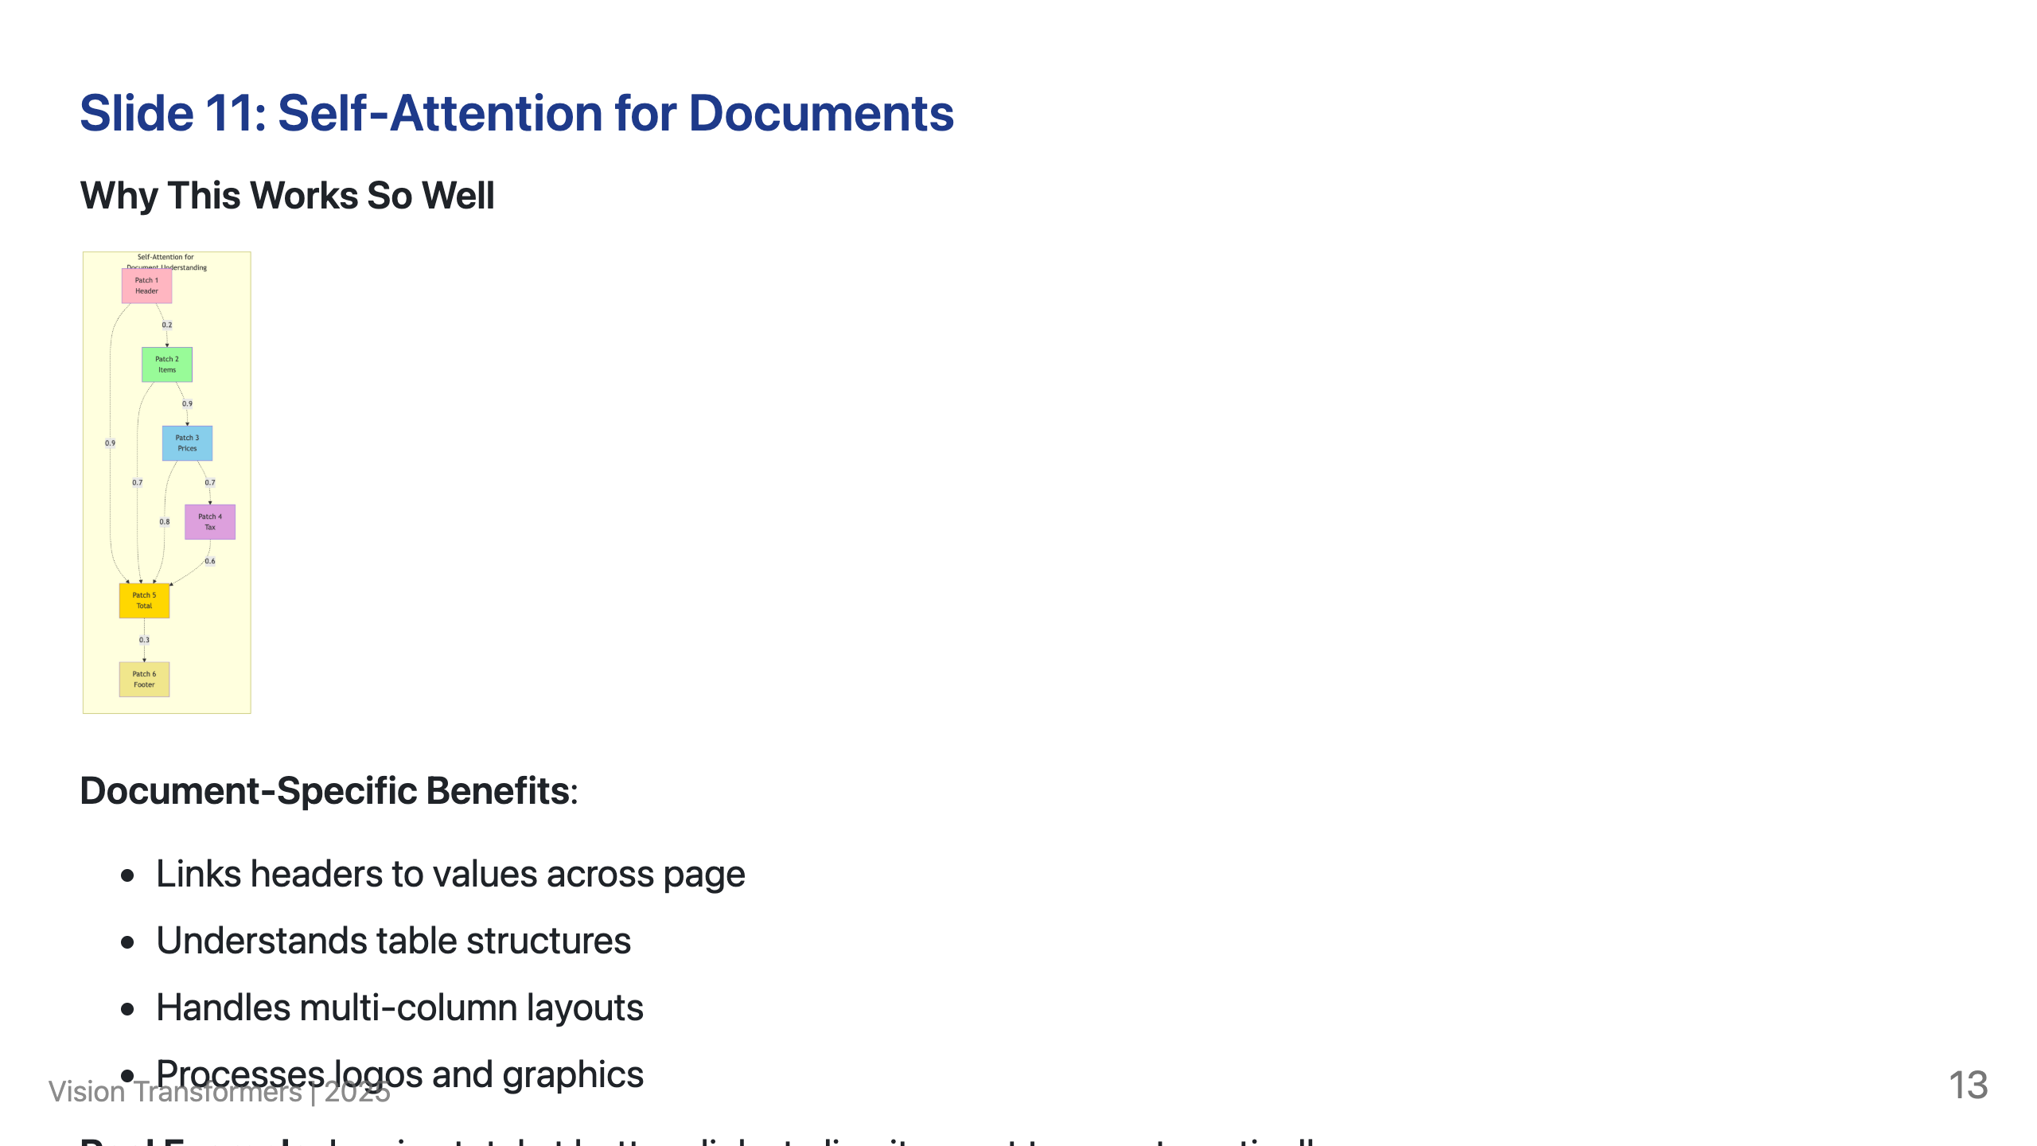
Notes:
Speaker Notes: Attention mechanisms naturally model document structure. Each patch can attend to every other patch, creating global understanding of relationships.

Slide 14
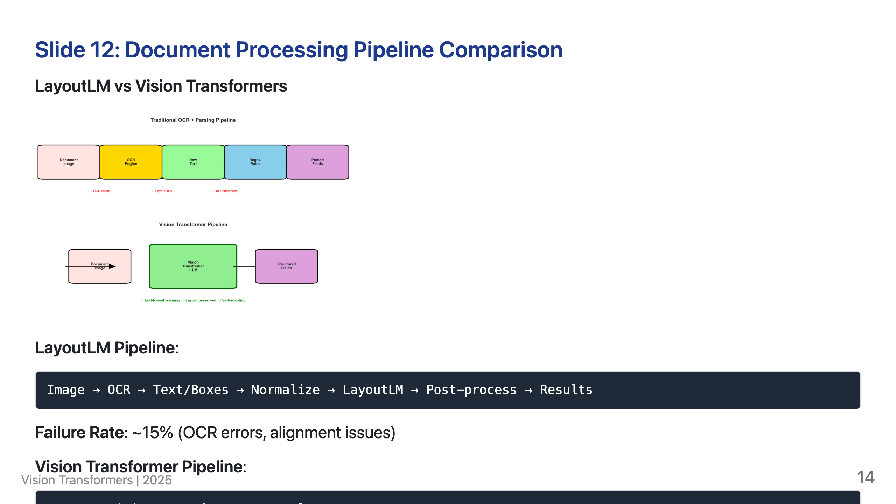
Notes:
Speaker Notes: Simplicity isn't just elegant - it's more reliable and maintainable. The LayoutLM pipeline has multiple failure points while Vision Transformers process everything end-to-end.

Slide 15
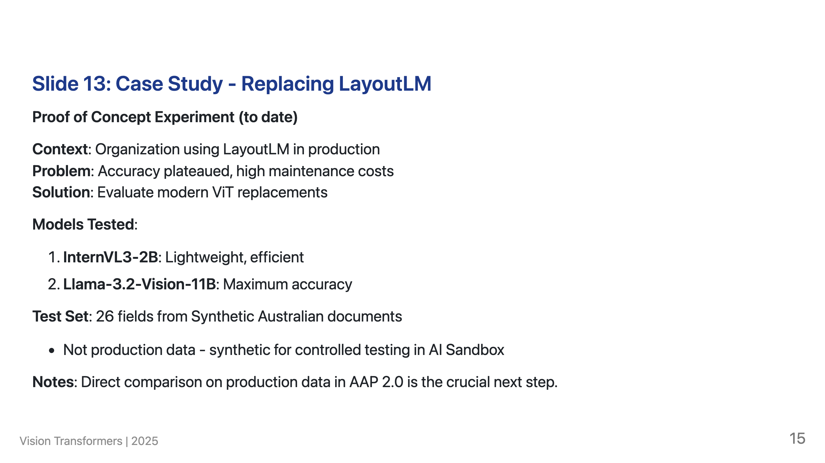

Slide 16
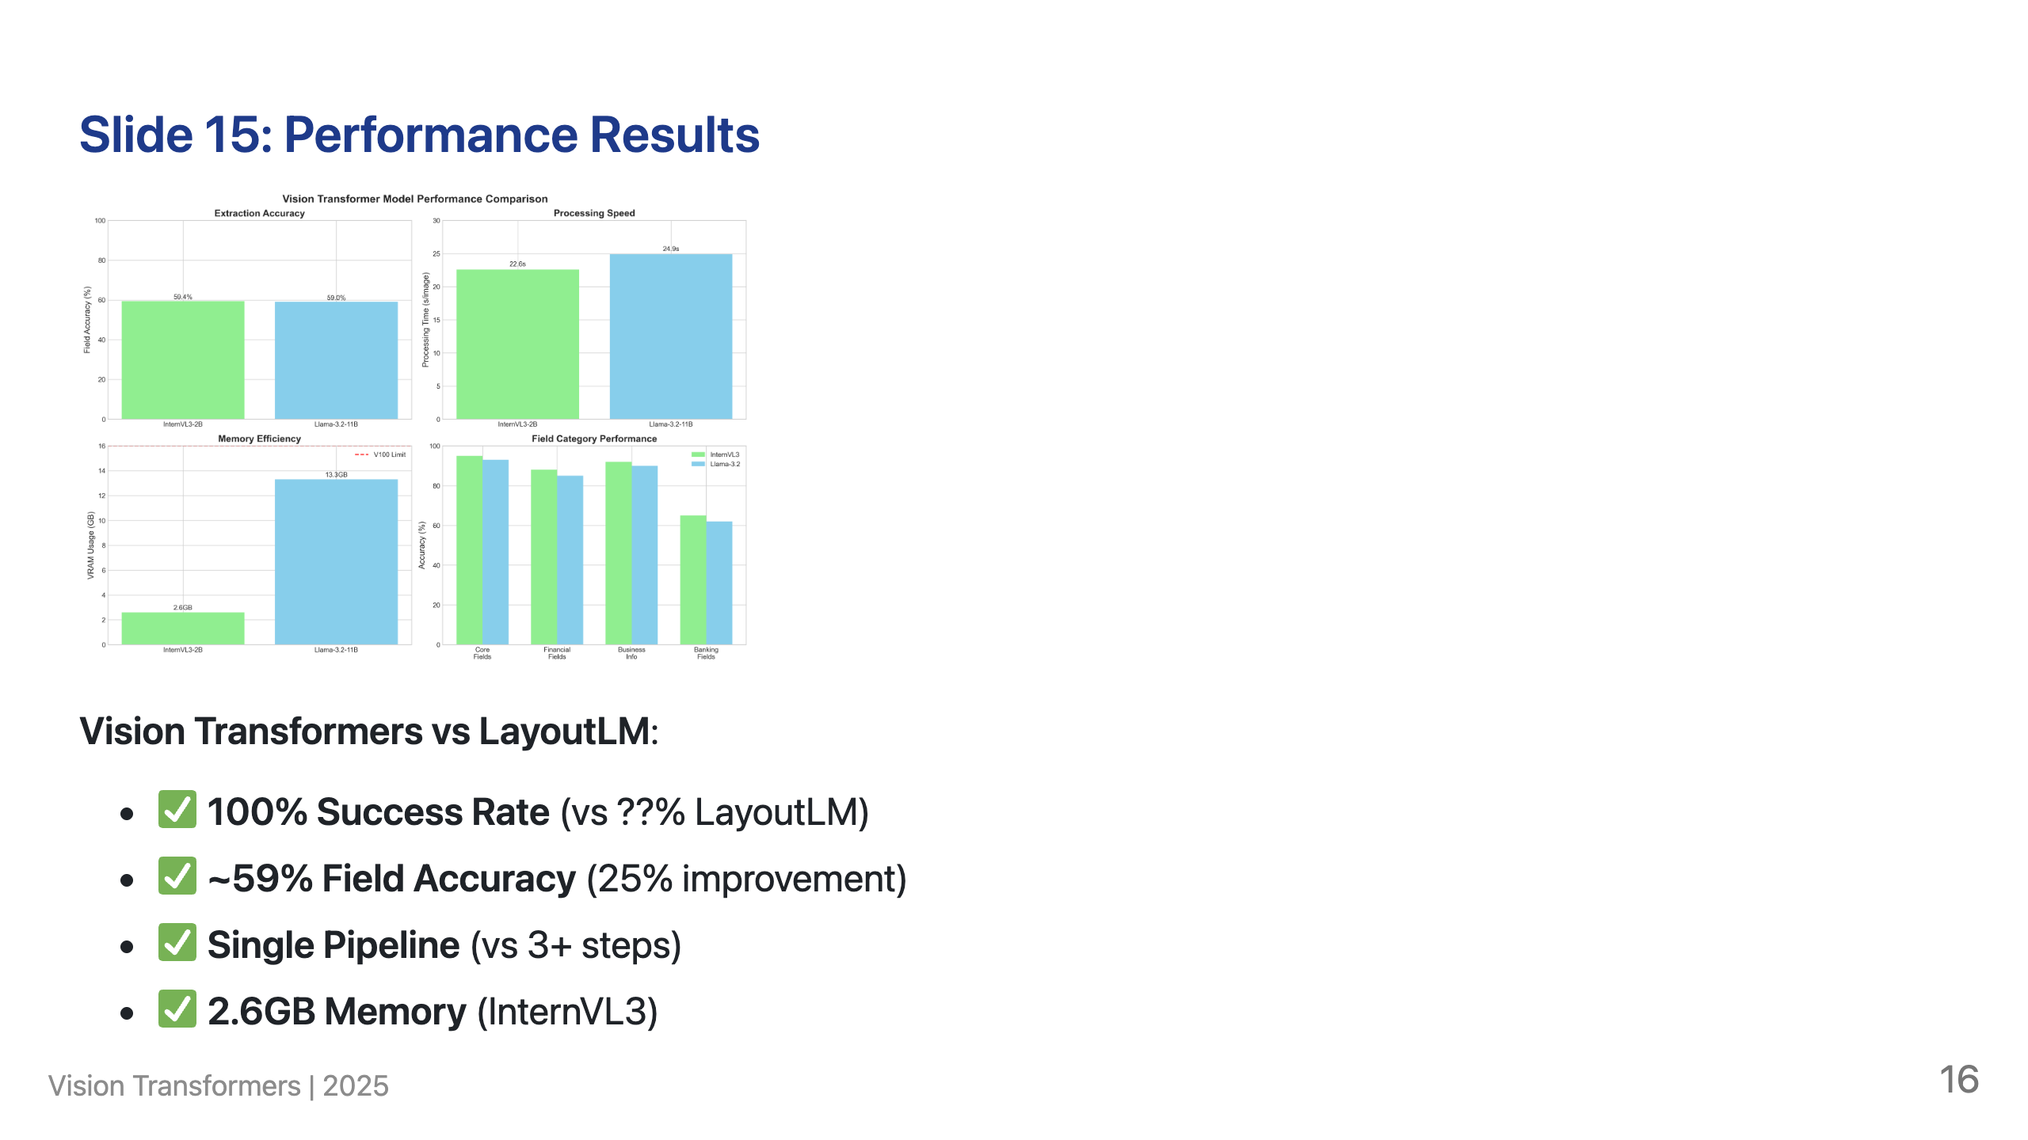
Notes:
Speaker Notes: Key insight - 25% accuracy improvement with 100% reliability. InternVL3 achieves better results than LayoutLM while using 67% less memory. Processing time is acceptable for production use.

Slide 17
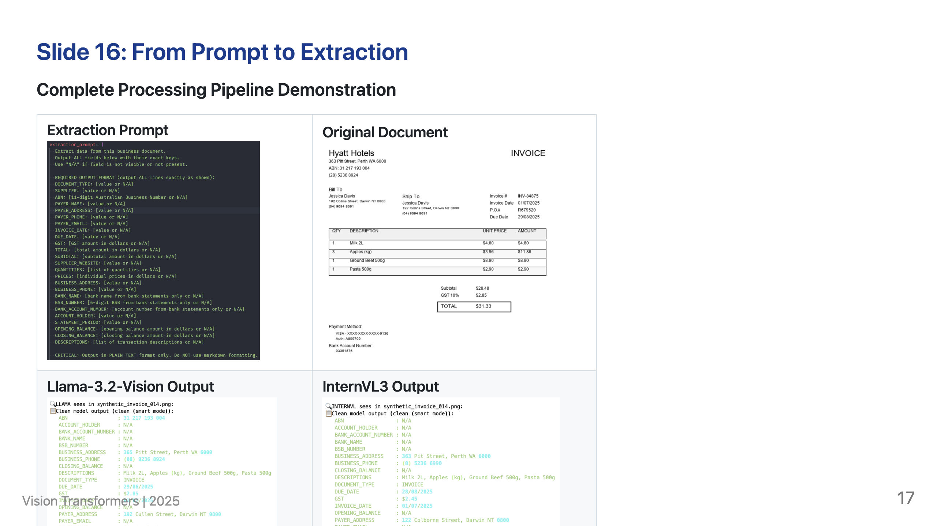

Slide 18
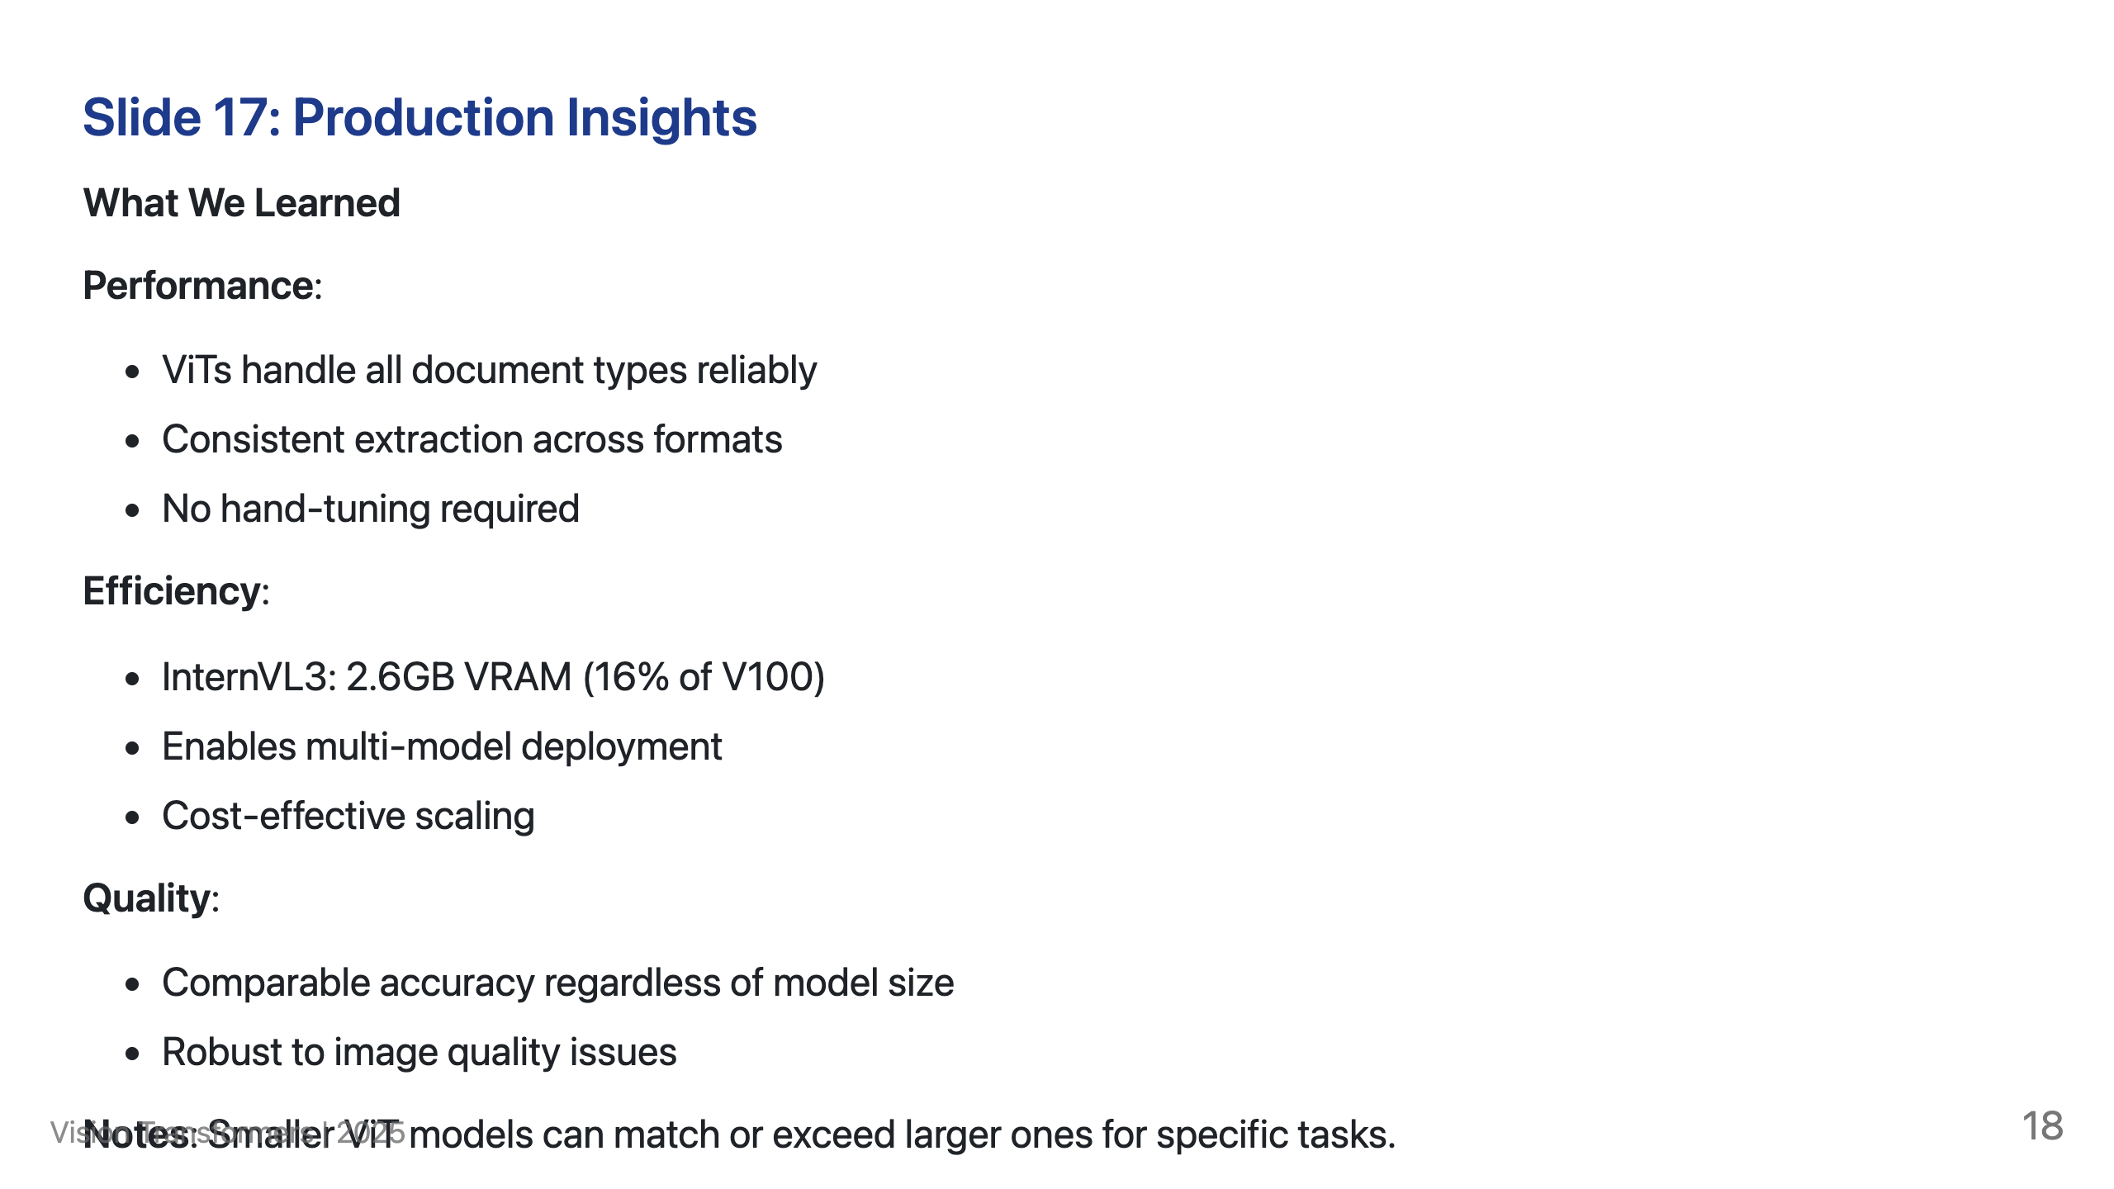

Slide 19
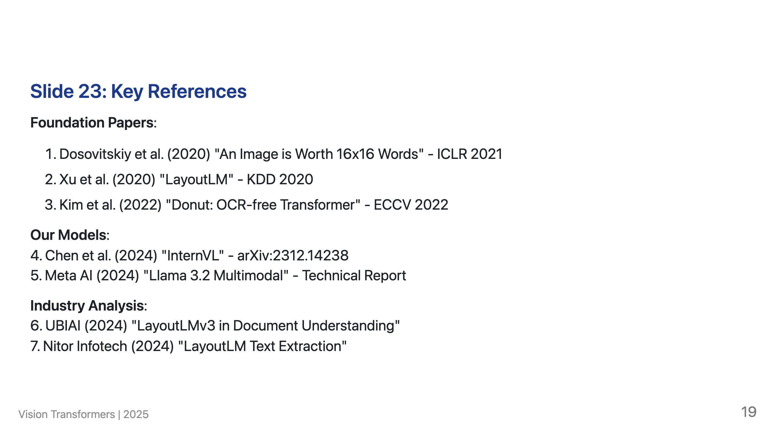
Notes:
Speaker Notes: Complete bibliography with 13 references available in shared research folder. Includes all LayoutLM versions, ViT foundations, comparison studies, and industry reports.

Slide 20
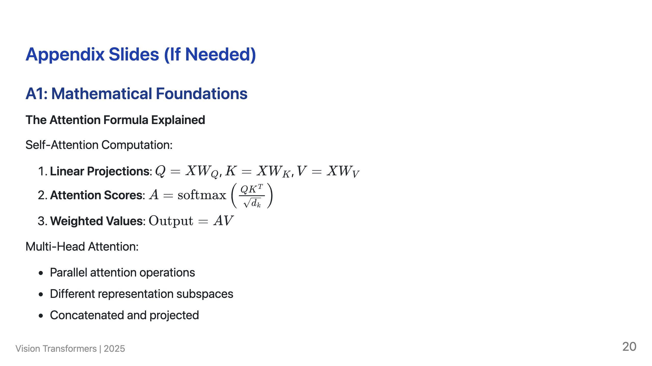

Slide 21
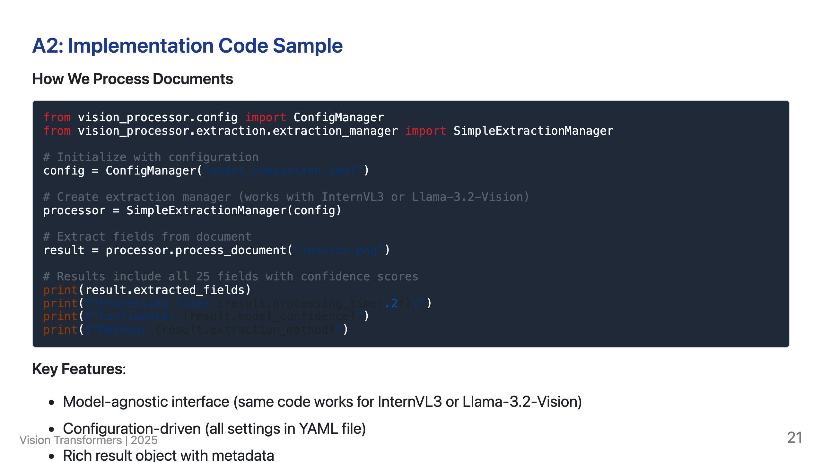

Slide 22
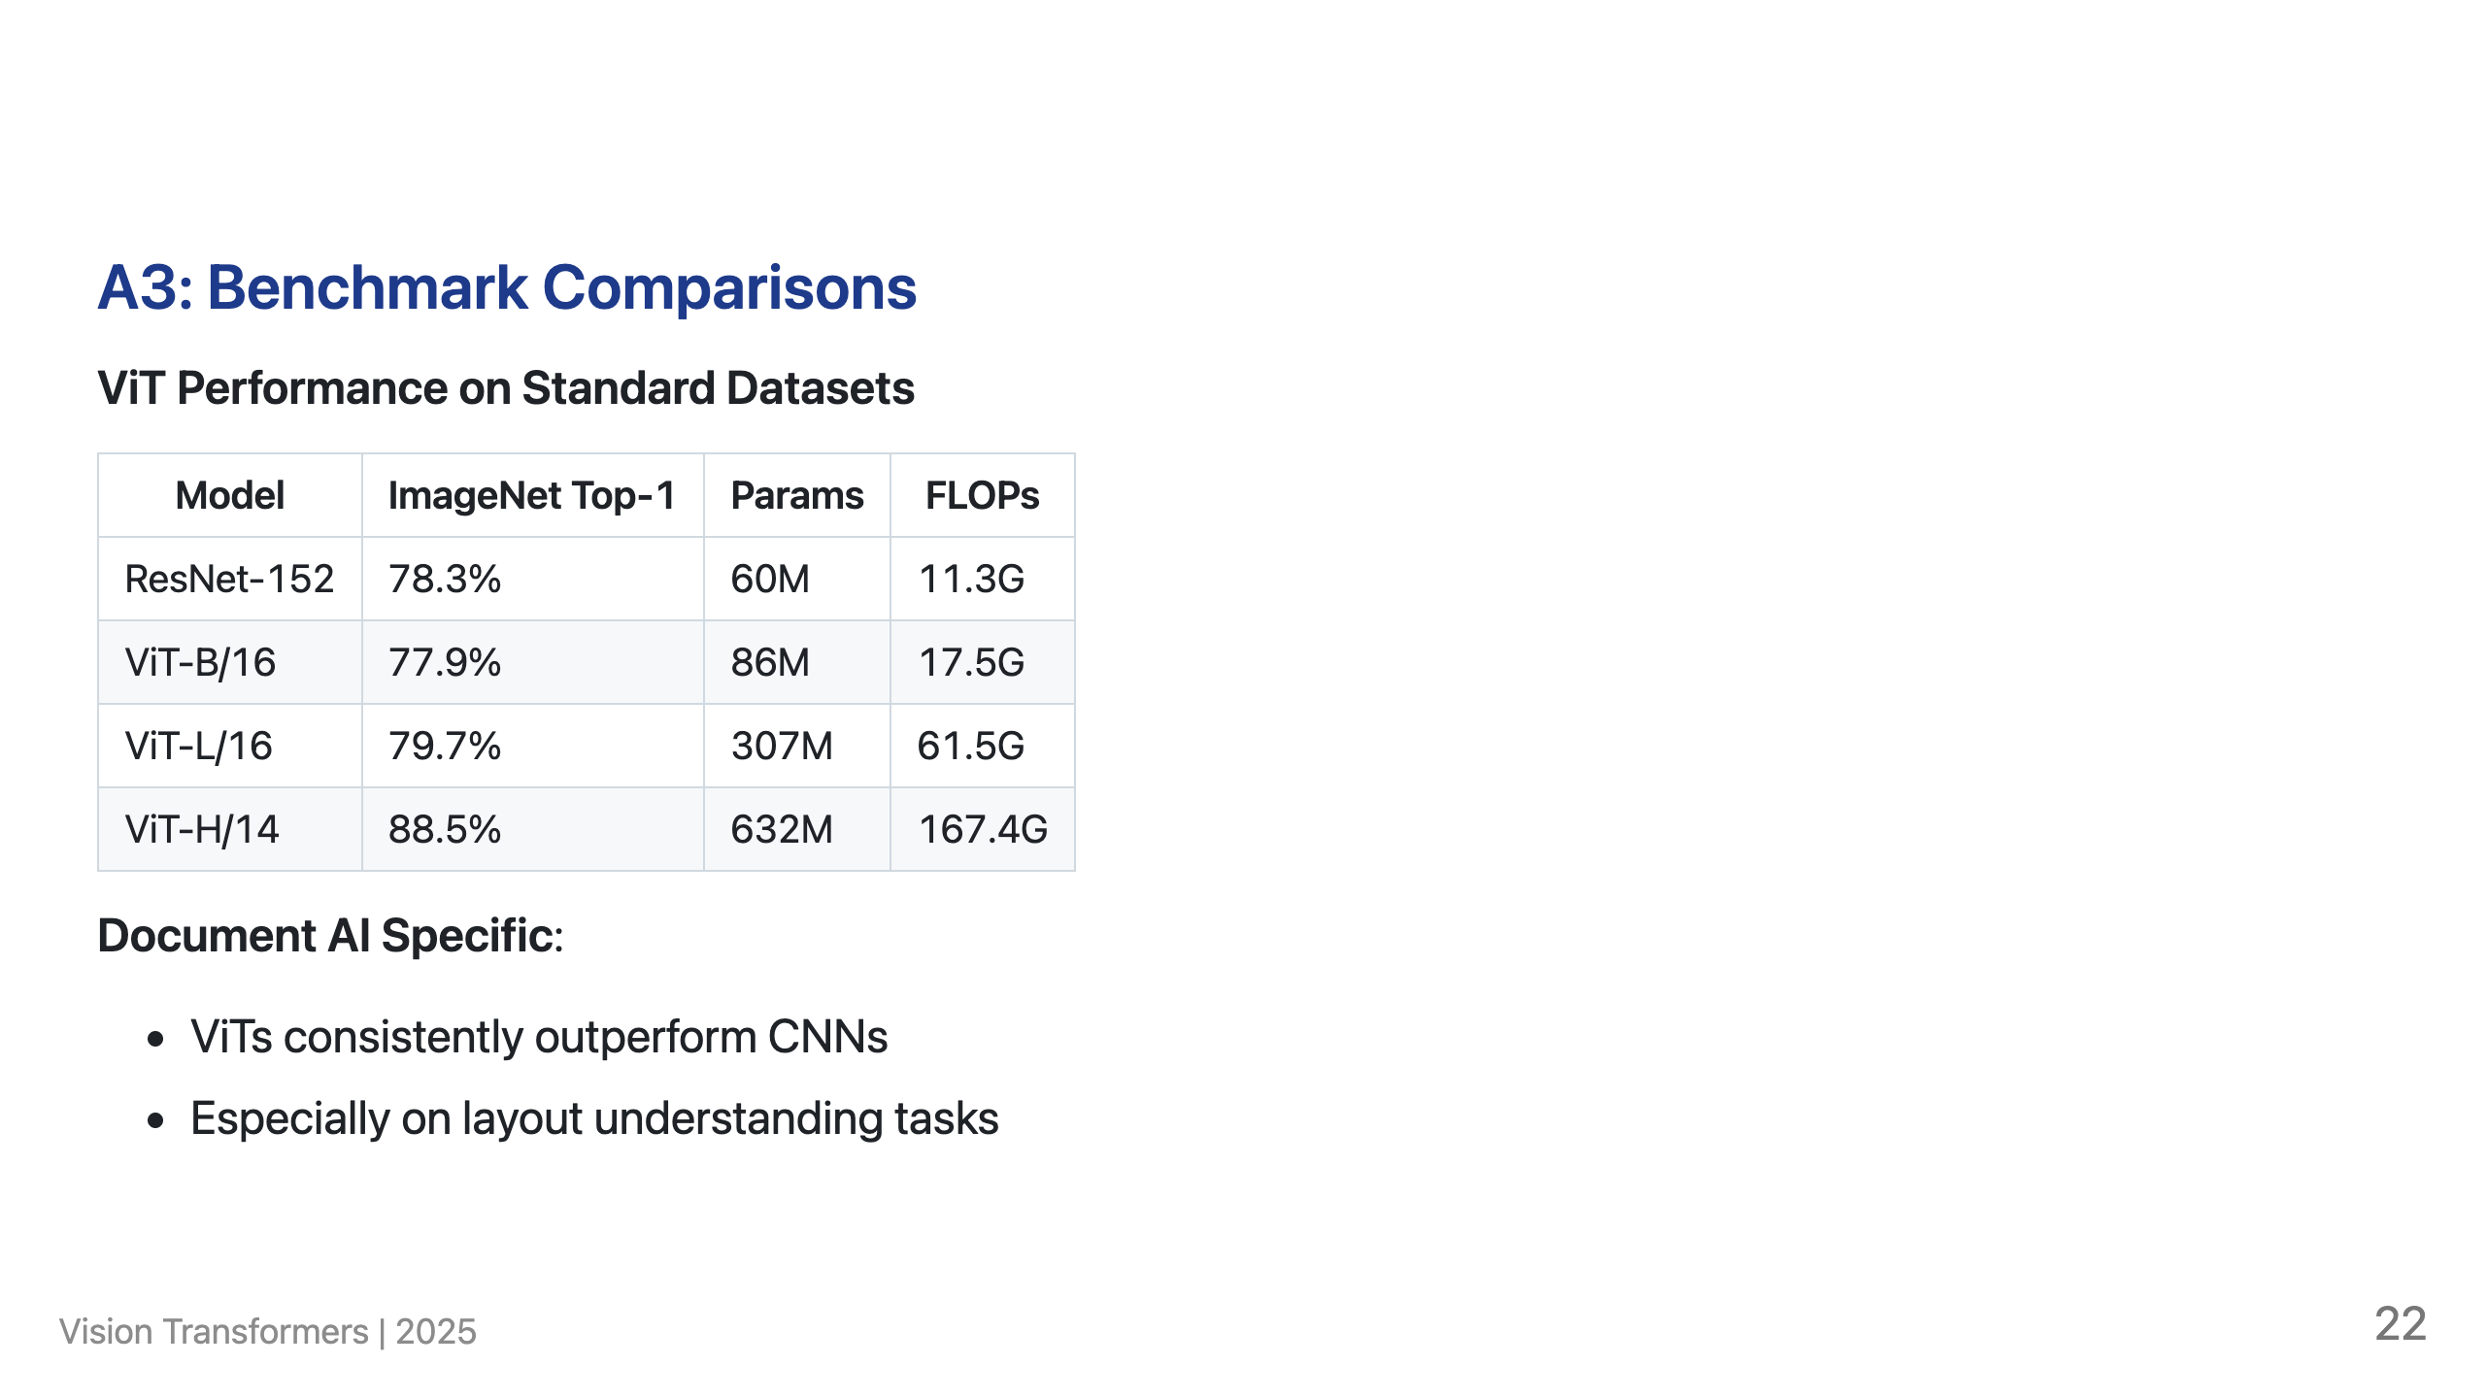

Slide 23
